Slide 1
1 Combinatorics
Exercises
1.1 Multiplication and Addition Principles
Multiplication Principle (MP). If a procedure can be described as a sequence of m independent steps, with i₁ possible outcomes for the first step, i₂ possible outcomes for the second step and so on, then the total number of composite outcomes of the procedure is given by
i₁ · i₂ · i₃ · . . . · i_{m} .
Note that the steps must be independent, i.e. the number of the outcomes of any one step is not affected by the outcomes of the steps before.

Slide 2
1 Combinatorics
Exercises
1.1 Multiplication and Addition Principles
Addition Principle (AP). If a procedure can be broken up into m different cases whose sets of outcomes are mutually exclusive (i.e. they cannot occur at the same time), with j₁ possible outcomes for the first case, j₂ possible outcomes for the second case and so on, then the total number of outcomes of the procedure is given by
j₁ + j₂ + j₃ + · · · + j_{m} .

Slide 3
Exercise 1. A man has 8 shirts, 4 pairs of trousers and 5 pairs of shoes. How many different outfits are possible?

Slide 4
Exercise 1. A man has 8 shirts, 4 pairs of trousers and 5 pairs of shoes. How many different outfits are possible?
Solution. We apply MP.
We have three (independent) steps to consider:
in the first one we choose a shirt (8 possibilities),
in the second one we choose a pair of trousers (4 possibilities) and
in the last one we choose a pair of shoes (5 possibilities).
The number of possible outfits is then
8 · 4 · 5 = 160 .

Slide 5
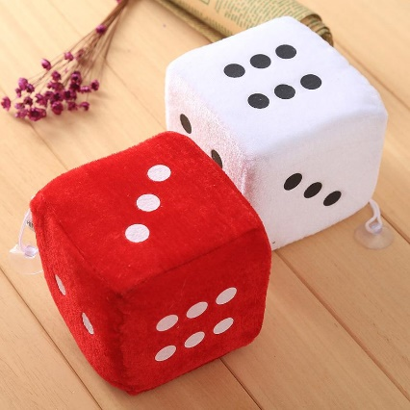

Exercise 2. Two dice are rolled, one red and one blue. How many different outcomes are possible? What if the two dice were identical?

Slide 6
Exercise 2. Two dice are rolled, one red and one blue. How many different outcomes are possible? What if the two dice were identical?
Solution. We apply MP.
We need to count all the possible configurations of type (i, j), where i denotes the outcome of the red die, and j denotes the outcome of the blue one.
Clearly, we have two (independent) steps to consider, and there are 6 possible outcomes for each die.
Then, 1 ≤ i, j ≤ 6.

Slide 7
Also, note that, since each die has a different color, an outcome when one die is i and the other j, i ≠ j, is represented by two different pairs, namely (i, j) and (j, i).
It is clear that we have
6 · 6 = 6² = 36
possible outcomes.

Slide 8
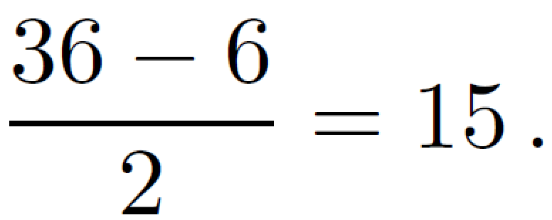
Consider now the case in which dice have the same color, i.e. they are identical. Clearly, 36 overestimates the number of distinguishable outcomes.
In particular, the outcomes when one die is i and the other j, i ≠ j, cannot be counted twice, as we previously did.
Since we have six configurations of type (i, i), 1 ≤ i ≤ 6, the number of these outcomes is
So we have 6 + 15 = 21 distinguishable outcomes.

Slide 9
Exercise 3. Two dice are rolled, one red and one blue. How many outcomes give the sum of 6? What if the two dice were identical?

Slide 10
Exercise 3. Two dice are rolled, one red and one blue. How many outcomes give the sum of 6? What if the two dice were identical?
Solution. Now we apply MP.
First suppose that dice have a different color.
We need to consider three different cases, as they all produce outcomes that give the sum of 6.
The first one is “one die is 1 and the other is 5”, whereas the second one is “one die is 2 and the other is 4”.

Slide 11
Note that they both can happen in two ways, since dice are distinguishable.
Finally, the last interesting case is “both dice are 3”.
Therefore the total number of useful outcomes is simply given by
2 + 2 + 1 = 5 .
If the dice were identical, the answer would be
1 + 1 + 1 = 3 .

Slide 12
Exercise 4. Find the number of distinct divisors of the integer 2520. How many even divisors does the number 2520 have?

Slide 13
Exercise 4. Find the number of distinct divisors of the integer 2520. How many even divisors does the number 2520 have?
Solution. Let us first write down the prime factorization of 2520,
2520 = 2 · 2 · 2 · 3 · 3 · 5 · 7 = 2³ · 3² · 5 · 7 .
Now recall that 2520 can be divided by an integer n if and only if n admits a prime factorization of the form
2^{i} · 3^{j} · 5^{k} · 7^{l},
where 0 ≤ i ≤ 3, 0 ≤ j ≤ 2, 0 ≤ k ≤ 1 and 0 ≤ l ≤ 1.

Slide 14
Now we apply MP. Our procedure is made up of four independent steps.
We first choose i (4 possibilities), then we choose j (3 possibilities), then k (2 possibilities) and finally l (2 possibilities).
So the total number of divisors is given by
4 · 3 · 2 · 2 = 48 .

Slide 15
How many of them are even?
Note that they must have a prime factorization of the form 2^{i} · 3^{j} · 5^{k} · 7^{l} with 1 ≤ i ≤ 3, 0 ≤ j ≤ 2, 0 ≤ k ≤ 1 and 0 ≤ l ≤ 1, and thus their number is
3 · 3 · 2 · 2 = 36 .

Slide 16
Exercise 5. How many binary sequences of length 8 either start with a 1 or end with a 1 or both? How many binary sequences of length 8 either start with 100 or have the fourth bit 1 or both?

Slide 17
Exercise 5. How many binary sequences of length 8 either start with a 1 or end with a 1 or both? How many binary sequences of length 8 either start with 100 or have the fourth bit 1 or both?
Solution. A binary sequence is a sequence whose elements come from the set {0, 1}.
Let us first answer the first question.
We must be careful when applying AP, as the intersections among the different cases we wish to consider must be empty.

Slide 18
1) The binary sequence starts with a 1 and does not end with a 1.
We now apply MP. Such a string can be constructed in six successive steps.
Choose the second bit, choose the third bit and so on until the seventh bit.
Note that the last bit must be 0.
Each bit can be selected in two ways, and thus there are
2 · 2 · 2 · 2 · 2 · 2 = 2⁶ = 64
possible different sequences.

Slide 19
2) The binary sequence ends with a 1 and does not start with a 1.
By MP, we get again
2⁶ = 64
possible different sequences.

Slide 20
3) The binary sequence starts and ends with a 1.
By MP, we get again
2⁶ = 64
possible different sequences.
By AP, the number of binary sequence of length 8 that either start with 1 or end with 1 or both is finally given by
64 + 64 + 64 = 192.
We answer the second question in a similar way. We apply again AP.

Slide 21
1) The binary sequence starts with 100 and does not have the fourth bit equal to 1.
We now apply MP.
Such a string can be constructed in four successive steps.
Indeed, note that the first four bits are fixed. Choose the fifth bit, choose the sixth bit and so on until the eighth bit.
Each bit can be selected in two ways, and thus there are
2 · 2 · 2 · 2 = 2⁴ = 16
possible different sequences.

Slide 22
2) The binary sequence has the fourth bit equal to 1 and does not start with 100.
By counting the number of sequences we do not want, i.e. the ones that start with 100 and have the fourth bit equal to 1, we get
2⁷ − 2⁴ = 128 − 16 = 112
possible different sequences.

Slide 23
3) The binary sequence starts with 100 and has the fourth bit equal to 1.
By MP, we get again
2⁴ = 16
possible different sequences.
By AP, the number of binary sequence of length 8 that either start with 100 or have the fourth bit 1 or both is finally given by
16 + 112 + 16 = 144.

Slide 24
Exercise 6. How many binary sequences of length 8 have at least one 0 and one 1? And how many have at least two 0’s?

Slide 25
Exercise 6. How many binary sequences of length 8 have at least one 0 and one 1? And how many have at least two 0’s?
Solution. In order to answer the questions, let us count the number of sequences we do not want.
There are just two strings that do not have at least one 0 and one 1, namely 00000000 and 11111111.
Since the total number of possible sequences is 2⁸ = 256, then the number of sequences we want is
256 − 2 = 254 .

Slide 26
Similarly, there is one sequence with no 0’s and eight sequences with exactly one 0.
Thus the number of sequences with at least two 0’s is
256 − 9 = 247 .

Slide 27
Exercise 7. Letters A, B, C, D and E are to be used to form strings of length 3.

Slide 28
Exercise 7. Letters A, B, C, D and E are to be used to form strings of length 3.
How many strings can be formed if we allow repetitions?
How many strings can be formed if we do not allow repetitions?
How many strings begin with A, allowing repetitions?
How many strings begin with A if repetitions are not allowed?
How many strings do not contain the letter A, allowing repetitions?
How many strings do not contain the letter A if repetitions are not allowed?
How many strings contain the letter A, allowing repetitions?
How many strings contain the letter A if repetitions are not allowed?

Slide 29
Solution. Let us consider each question in turn.
1. We apply MP.
The string is of length 3, and we have 5 choices for each position.
The answer is
5 · 5 · 5 = 5³ = 125 .
2. We apply MP.
We have 5 choices for the first position, 4 choices for the second position and 3 choices for the third one.
The answer is 5 · 4 · 3 = 60 .

Slide 30
3. We apply MP.
The first position is fixed, then we have 5 choices for the second and third position.
The answer is
5 · 5 = 5² = 25 .
4. We apply MP.
Again, the first position is fixed, and we have 4 choices for the second position and 3 choices for the third position.
The answer is
4 · 3 = 12 .

Slide 31
5. We apply MP.
We have 4 choices for each position.
The answer is
4 · 4 · 4 = 4³ = 64 .
6. We apply MP.
We have 4 choices for the first position, 3 choices for the second position and 2 choices for the third position.
The answer is
4 · 3 · 2 = 24 .

Slide 32
7. We apply AP. Consider the following seven cases:
A occupies just position one.
We have 4 choices for the second and third position. In total 4 · 4 = 4² = 16.
A occupies just position two.
We have 4 choices for the first and third position. In total 4 · 4 = 4² = 16.
A occupies just position three.
We have 4 choices for the first and second position. In total 4 · 4 = 4² = 16.

Slide 33
A occupies position one and position two.
We have 4 choices for the third position.
A occupies position one and position three.
We have 4 choices for the second position.
A occupies position two and position three.
We have 4 choices for the first position.
A occupies position one, two and three.
Obviously just one string satisfies this condition.

Slide 34
Thus the number of strings that contain the letter A (assuming that repetitions are not allowed) are
16 + 16 + 16 + 4 + 4 + 4 + 1 = 61 .

Slide 35
An easier way to answer the question would have been counting the number of strings we do not want, i.e. the ones that do not contain A.
Their number is simply
4 · 4 · 4 = 4³ = 64 ,
and thus the answer is
125 − 64 = 61 .

Slide 36
8. We apply AP. Consider the following three cases:
A occupies position one.
We have 4 choices for the second position and 3 choices for the third position. In total 4 · 3 = 12.
A occupies position two.
We have 4 choices for the first position and 3 choices for the third position. In total 4 · 3 = 12.
A occupies position three.
We have 4 choices for the first position and 3 choices for the second position. In total 4 · 3 = 12.

Slide 37
Thus the number of strings that contain the letter A (assuming that repetitions are allowed) are
12 + 12 + 12 = 36 .

Slide 38
Again, let us give an alternative proof by counting the number of strings we do not want, i.e. the ones that do not contain A.
Their number is simply
4 · 3 · 2 = 24 ,
and thus the answer is
60 − 24 = 36 .

Slide 39

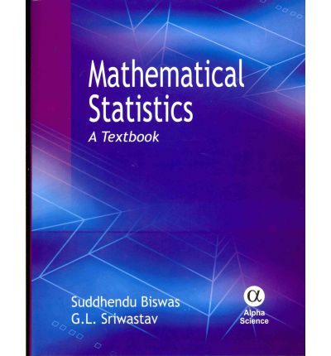

Exercise 8. We have a set of five distinct computer science books, three distinct maths books and two distinct art books.

Slide 40
Exercise 8. We have a set of five distinct computer science books, three distinct maths books and two distinct art books.
In how many ways can these books be arranged on a shelf ?
In how many ways can these books be arranged on a shelf if all five computer science books are on the left and both art books are on the right?
In how many ways can these books be arranged on a shelf if all five computer science books are on the left?
In how many ways can these books be arranged on a shelf if all books of the same subject are grouped together?
In how many ways can these books be arranged on a shelf if the two art books are not together?

Slide 41
Solution. Let us consider each question in turn.
1. We apply MP.
We have in total 5 + 3 + 2 = 10 positions on the shelf.
We have 10 choices for the first position, 9 choices for the second position and so on.
The answer is
10 · 9 · 8 · . . . · 2 · 1 = 3628800 .

Slide 42
2. We apply MP.
From left to right, we have 5 choices for the first position, 4 choices for the second position and so on until we have just 1 possible choice for the fifth position.
Then we have 3 choices for the sixth position, 2 choices for the seventh position and 1 choice for the eighth position.
Finally, we have 2 choices for the ninth position and 1 choice for the tenth position.
The answer is
5 · 4 · 3 · 2 · 1 · 3 · 2 · 1 · 2 · 1 = 1440 .

Slide 43
3. We apply MP.
Recall that we have 3 + 2 = 5 books that are not computer science books.
From left to right, we have 5 choices for the first position, 4 choices for the second position and so on until we have just 1 possible choice for the fifth position.
Then we have 5 choices for the sixth position, 4 choices for the seventh position and so on until we have just 1 choice for the tenth position.
The answer is
5 · 4 · 3 · 2 · 1 · 5 · 4 · 3 · 2 · 1 = 14400 .

Slide 44
4. We apply AP.
Consider the following six cases and note that each one produces 1440 possible outcomes.
All computer science books are on the left and all art books are on the right.
All computer science books are on the left and all maths books are on the right.
All art books are on the left and all computer science books are on the right.
All art books are on the left and all maths books are on the right.
All maths books are on the left and all computer science books are on the right.
All maths books are on the left and all art books are on the right.
Thus the answer is 1440 · 6 = 8640 .

Slide 45
5. Let us first count the number of configurations we do not want.
We apply MP.
Consider the following steps:
first we choose two consecutive positions for the art books (9 possibilities),
then we arrange the art books in these positions (2 possibilities)
and finally we arrange the remaining 10 − 2 = 8 books in the remaining positions (8 · 7 · · · · · 2 · 1 = 40320 possibilities).

Slide 46
Thus the number of configurations we do not want is
9 · 2 · 40320 = 725760 ,
and the number of configurations we want is
3628800 − 725760 = 2903040 .

Slide 47


